Slide 1

American Gut Project
8/15/2017
Alyssa Monda
acmonda@emory.edu
https://github.com/amonda

Slide 2
Objectives
Review the AGP, including the:
Purpose
Methods
Explain how to access the available dataset
Overview of the:
Demographics
Metadata
Notes:
Redo this slide

Slide 3
What is THE AGP?
Largest crowdsourced citizen science project to date
Founded in 2012 by Jeff Leach and Rob Knight
>10,000 participants
Fecal, Oral, or Skin
Detailed health, lifestyle, and diet data
Based out of Rob Knight’s Lab at UCSD
Encompasses British and Australian Gut Projects
Notes:
The American Gut project is the largest crowdsourced citizen science project to date. Fecal, oral, skin, and other body site samples collected from thousands of participants represent the largest human microbiome cohort in existence. Detailed health and lifestyle and diet data associated with each sample is enabling us to deeply examine associations between the human microbiome and factors such as diet (from vegan to near carnivore and everything in between), season, amount of sleep, and disease states such as IBD, diabetes, or autism spectrum disorder-as well as many other factors not listed here. The American Gut project also encompasses the British Gut and Australian Gut projects, widening the cohort beyond North America. As the project continues to grow, we will be able to identify significant associations that would not be possible with smaller, geographically and health/disease status-limited cohorts.

Slide 4
How does it work?
Sample kit sent via snail mail
Oral: Tongue
Skin: Forehead or palm
Fecal: Caught on toilet paper
Online questionnaires
Processed using protocols listed by Earth Microbiome Project
80,000 samples in EMP it can thus be combined with or compared to
16s rRNA, MiSeq Illumina
QIIME
Ipython notebook describing processing steps
Open access data
Warning: Estimated time of processing all data is 5,000 CPU hours
7 months on your laptop
Notes:
Process 88 samples at a time to isolate DNA and 16S rRNA amplification
Plus 8 blank wells
Sequence 528 wells together
Rub 20 seconds on tongue or skin

Slide 5
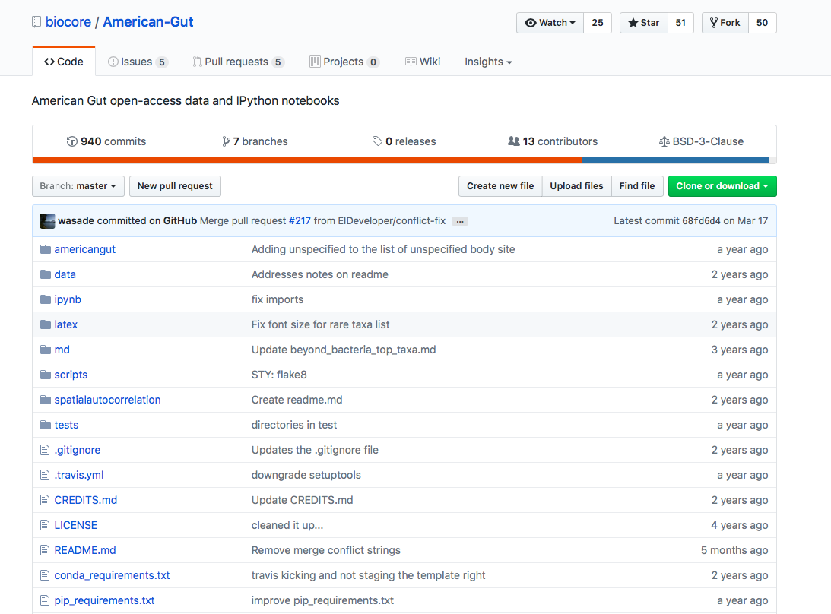
How can we Access the data?
Option 1: The AG GitHub repository (https://github.com/biocore/American-Gut)
Data from
American Gut
Human Microbiome
Global Gut
Personal Genome Project
Open-access code and IPython notebooks
Last updated May 2015
Does not contain latest data
Different survey and dietary questionnaire

Slide 6
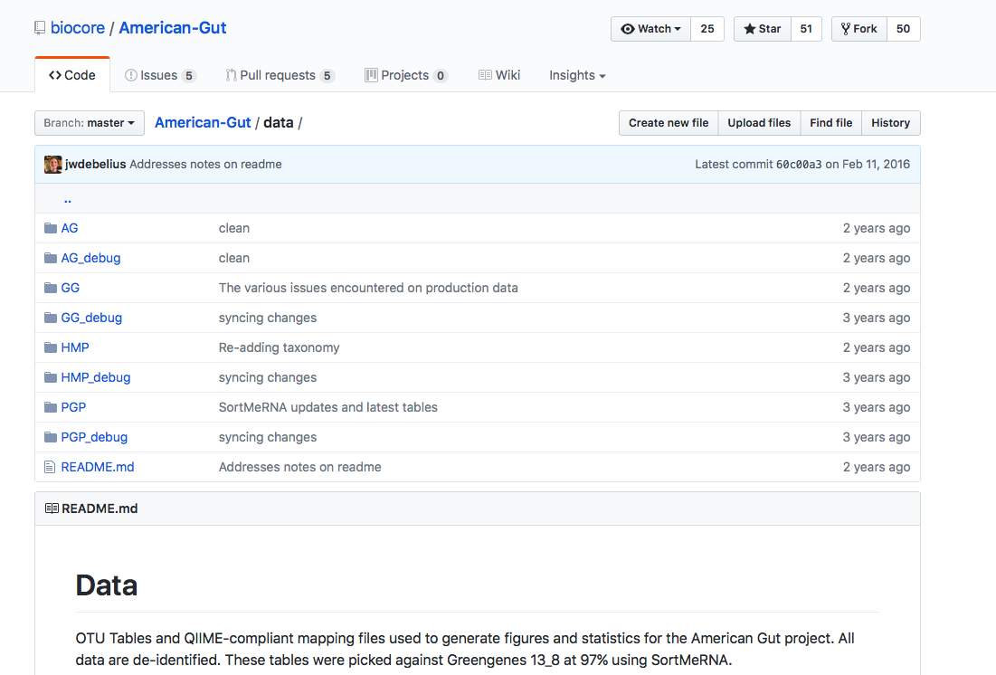
Accessing the data
Option 1: The AG GitHub repository (https://github.com/biocore/American-Gut)
Data from
American Gut
Human Microbiome
Global Gut
Personal Genome Project
Open-access code and IPython notebooks
Debugged are 10% random subsets
Reduces processing loads on framework
Run tests faster to ensure code works

Slide 7
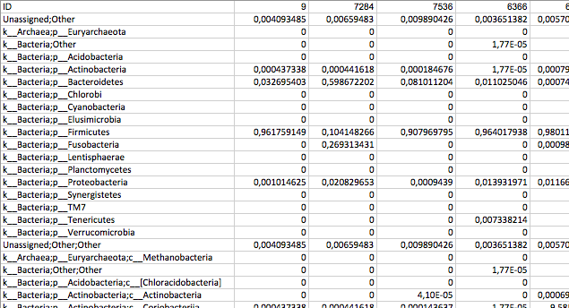
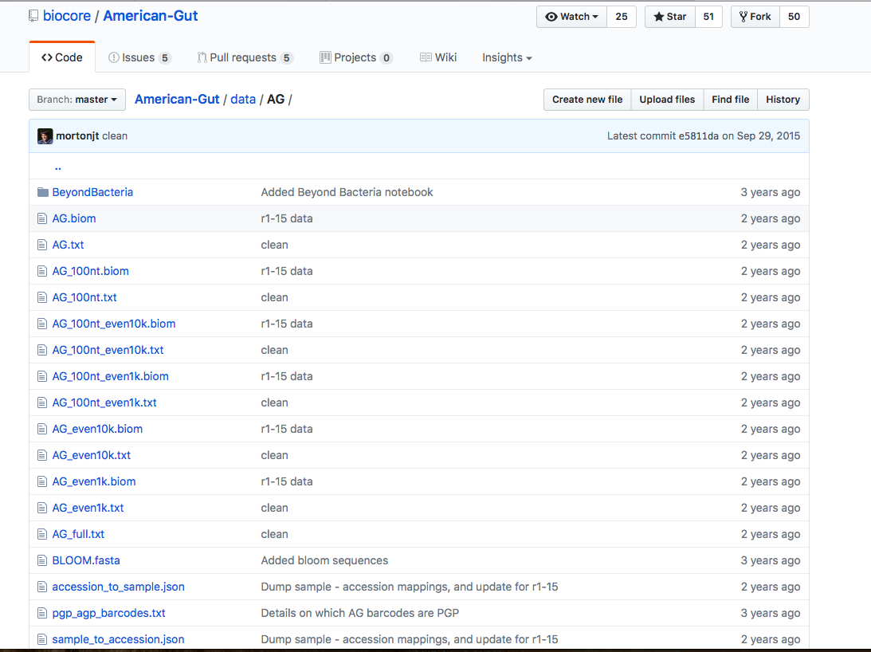
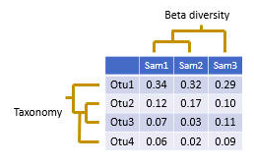
Accessing the data
Option 1: The AG GitHub repository (https://github.com/biocore/American-Gut)
100nt: sequences were trimmed to 100 nucleotides prior to OTU picking
even1k: full table was rarified to 1000 sequences per sample
Even10k: full table was rarified to 10000 sequences per sample
“.txt”: metadata
“.biom”: Processed OTU, taxonomy
QIIME 1
Picked against Greengenes 13_8 at 97% OTUs using SortMeRNA
Notes:
More sequences to identify to a lower taxonomic level? Differentiate between species in a more diverse sample?
Counts

Slide 8
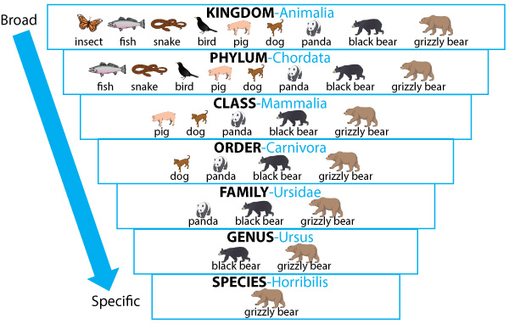
Biology Timeout
King
Phillip
Came
Over
For
Good
Spaghetti

Slide 9
Accessing the data
Option 1: The AG GitHub repository (https://github.com/biocore/American-Gut)
100nt: sequences were trimmed to 100 nucleotides prior to OTU picking
even1k: full table was rarified to 1000 sequences per sample
Even10k: full table was rarified to 10000 sequences per sample
“.txt”: metadata
“.biom”: Processed OTU, taxonomy
QIIME 1
Picked against Greengenes 13_8 at 97% OTUs using SortMeRNA
Notes:
More sequences to identify to a lower taxonomic level? Differentiate between species in a more diverse sample?

Slide 10
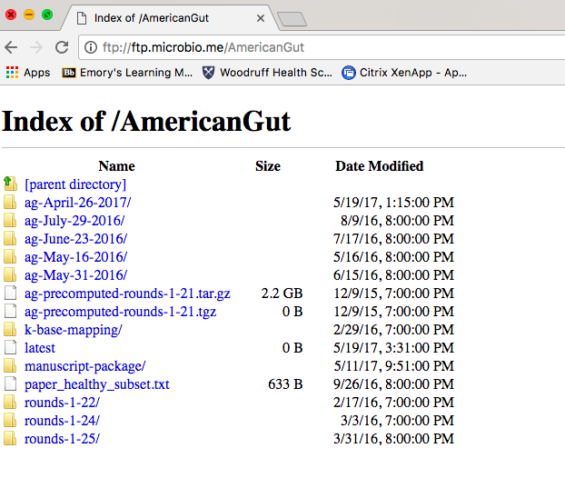
Accessing the data
Option 2: The AG website (ftp://ftp.microbio.me/AmericanGut)
New and old data
Using a PC or Chrome

Slide 11
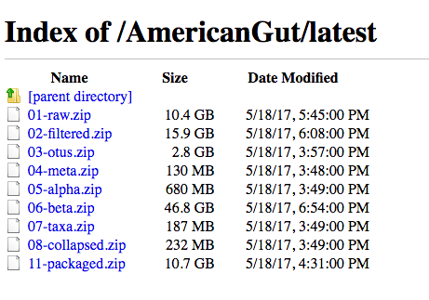
Accessing the data
Option 1: The AG website (ftp://ftp.microbio.me/AmericanGut)
New and old data
Sequences in “raw” also available in the European Nucleotide Archive http://www.ebi.ac.uk/ena/data/view/PRJEB11419
FASTQ
Links to NCBI SRA files

Slide 12

Accessing the data
Option 2: The AG website (ftp://ftp.microbio.me/AmericanGut)
New and old data
Using a MAC on Safari

Slide 13
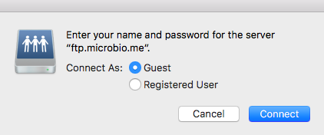
Accessing the data
Option 2: The AG website (ftp://ftp.microbio.me/AmericanGut)
New and old data

Slide 14
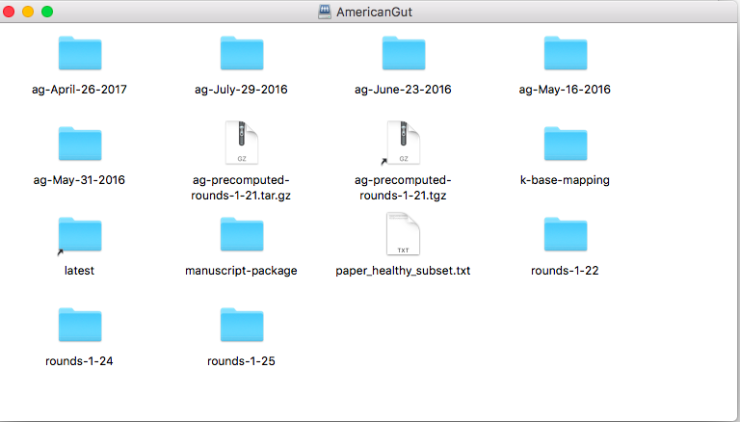
Accessing the data
Option 2: The AG website (ftp://ftp.microbio.me/AmericanGut)
New and old data

Slide 15
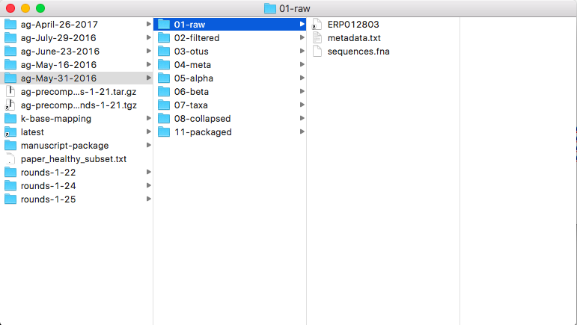
Accessing the data
Notes:
ERPO-> link to EMP site

Slide 16
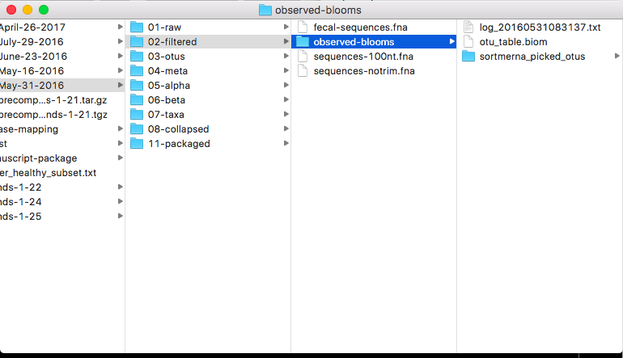
Accessing the data

Slide 17
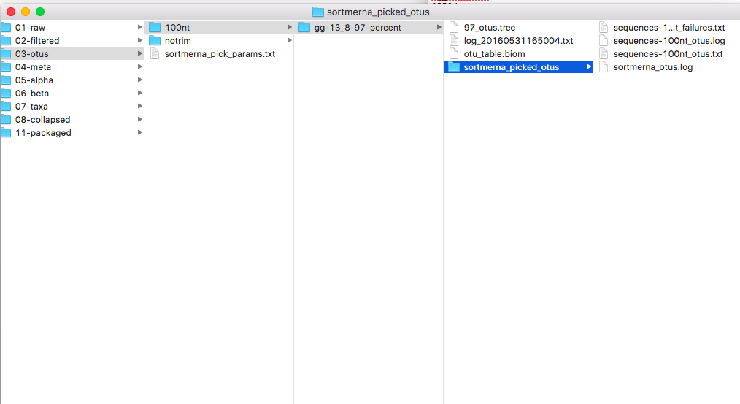
Accessing the data

Slide 18
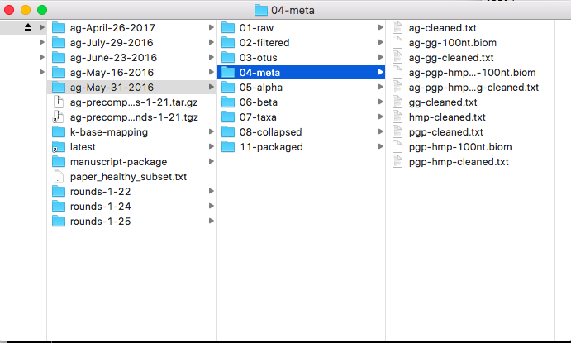
Accessing the data

Slide 19
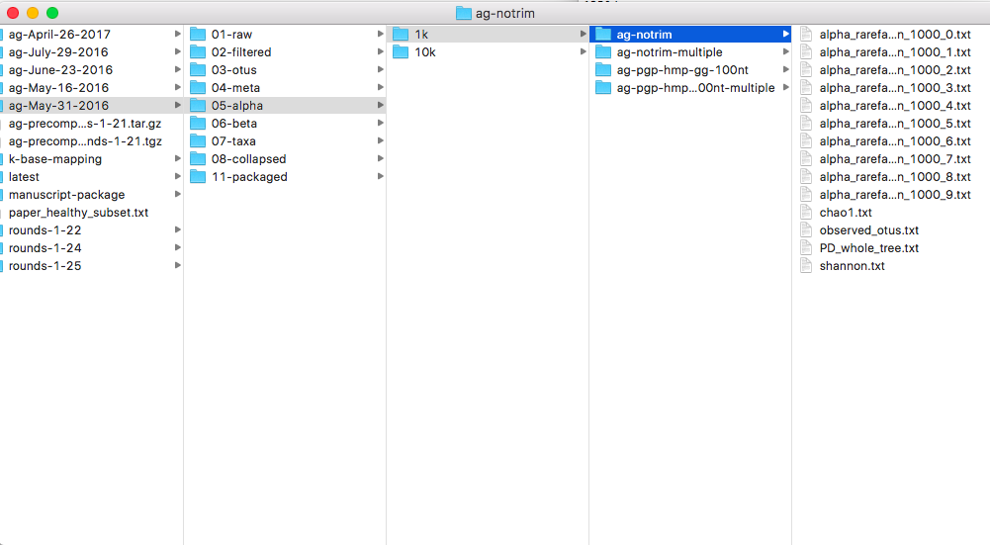
Accessing the data

Slide 20
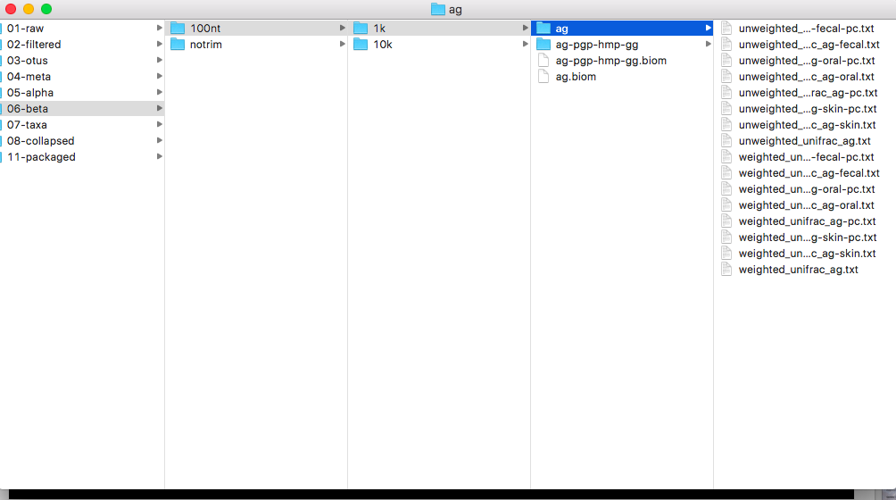
Accessing the data

Slide 21
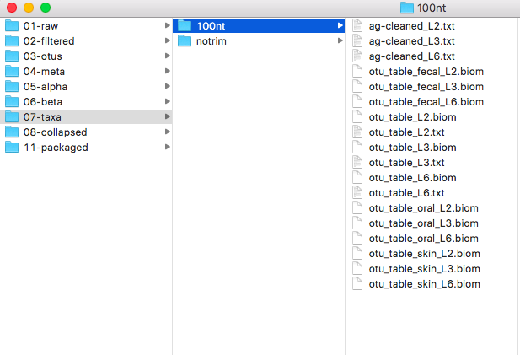
Accessing the data

Slide 22
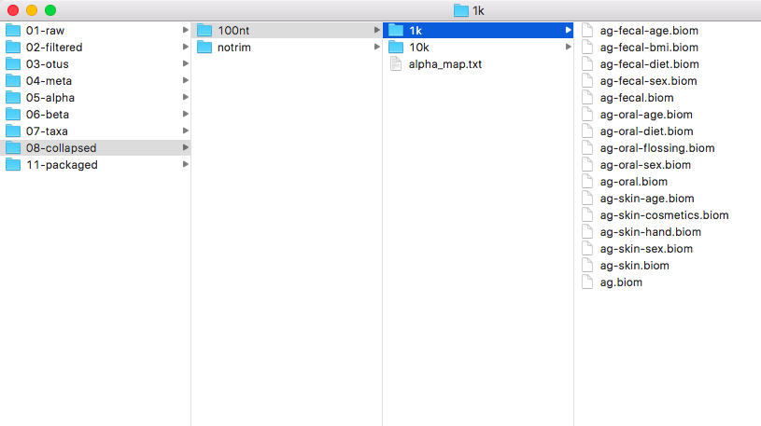
Accessing the data

Slide 23
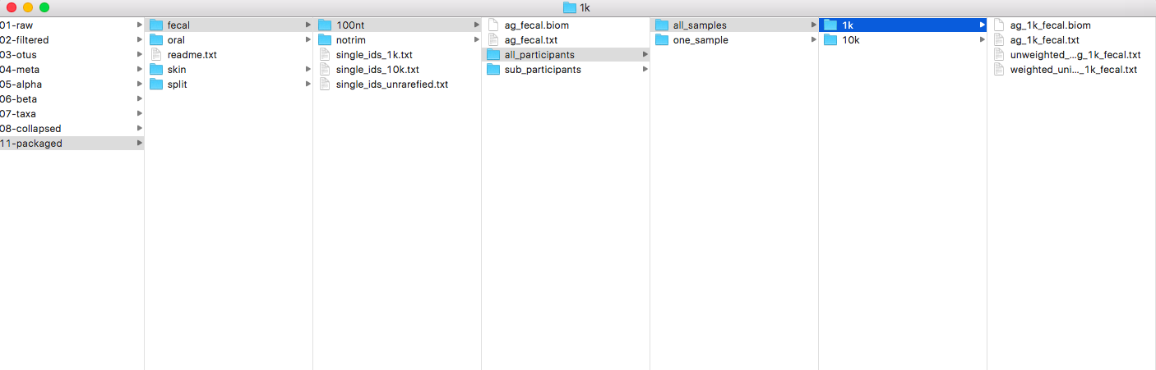
Accessing the data
Notes:
American Gut data was primarily divided by sequence trim length, bodysite and rarefaction depth. Trimmed sequences were used to facilitate meta analysis with other datasets. Participant results are returned at a lower rarefaction depth than are used in analysis. We've chosen to organize the data by bodysite, trim length, and then by rarefaction depth. For each bodysite and trim length, an unrarefied mapping file and biom table are provided. Data is additionally partitioned into all the samples from all participants at a particiular bodysite, and a single sample per indiviudual at each bodysite. The single sample was selected at random from all the samples from an individual which met the rarefaction criteria. This sample is used across all datasets. If no sample met the rarefaction critieria, the level is stepped down and the proceedure is repeated. This way, the sample selected for each individual is consistent across all the datasets while maximizing the number of samples for analysis.A list of the barcodes in each single sample dataset are provided for each bodysite (i.e. `single_1k.txt`).For the fecal samples, we additionally filtered the data to include samples from individuals in a healthy subset of adults. The criteria for a participant to be included in this group included a reported age between 20 and 69, a BMI between 18.5 and 30, and no reported history of Inflammatory Bowel Disease, Diabetes, or antibiotic use in the past year. A single sample per individual is provided in each subset.

Slide 24
Analyzing the data?
R
Variety of codes online
Key Packages
Dada2
Phyloseq
DeSeq2
QIIME or QIIME 2
Run separate sequences from EMP
May need quality info or demultiplexed files to compare to data processed by QIIME 2

Slide 25
Sample description
“Latest” data
14816 observations, 528 variables
Mean Age: 45
Babies: n=7
Children: n=551
Teen: n=305
20s, 30s, 40s, 50s, or 60s: n~2,000
Mean BMI: 23.9
Min: 9.63
Max: 76.89
Missing: 8,213
Sex
Males: n=6,639
Females: n=7,423
Race
Caucasian: n=12,916
Black: n=94
Asian/Pacific Islander: n=714
Hispanic: n=292
Education
Graduate Degree: n=4,288
Bachelor’s: n=2,415
Healthy
True: n=2,413
False: n= 8,561
Diabetes: n=203
CVD: n=335
Diet
Omnivore: n=11,783
Vegan: n=312
Link to GitHub HTML or PDF document with a more in depth overview:
https://github.com/amonda/American_Gut_08_15_2017
Notes:
Show PDF

Slide 26
More In Depth overview
Visit the HTML, PDF or R markdown file associated with the data exploration done for this presentation at:
https://github.com/amonda/American_Gut_08_15_2017
The file is called “Latest_Analysis_Demo”
A published version of the html file can be found at:
http://rpubs.com/acmonda/AG

Slide 27
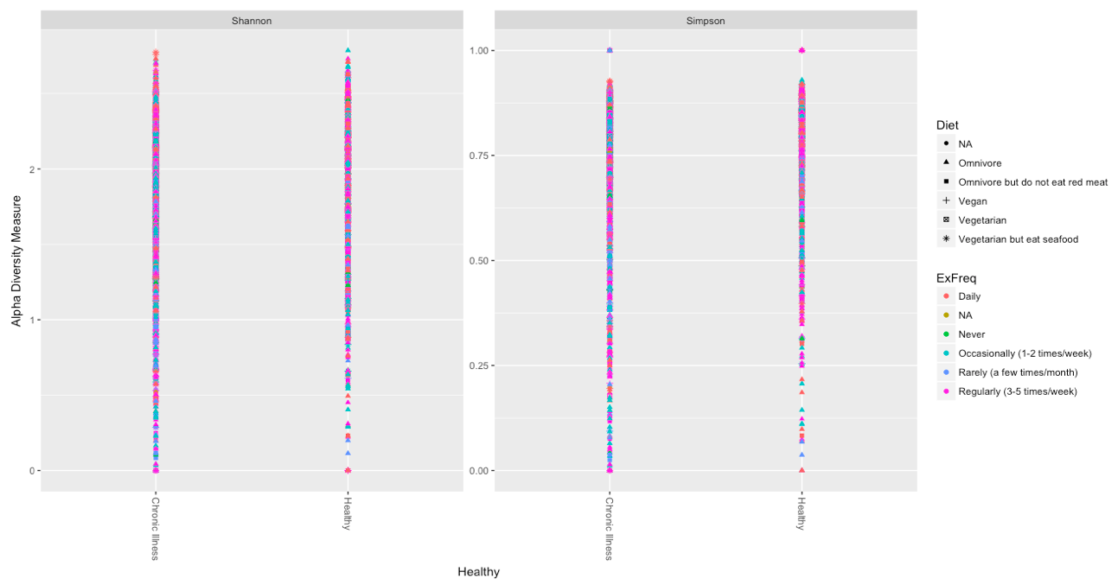
Microbiome Analysis

Slide 28
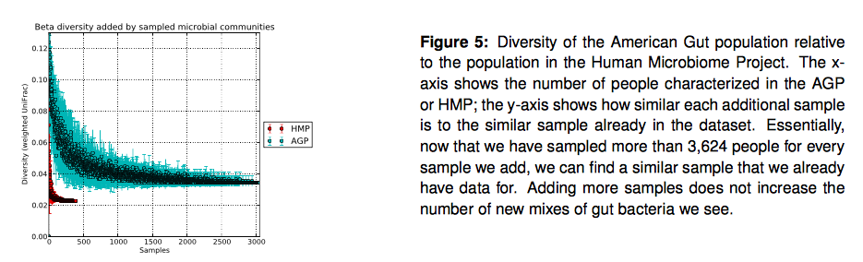
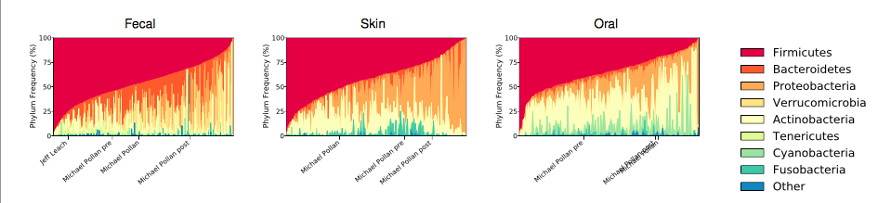
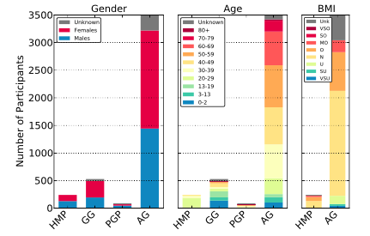
Preliminary results
As of November 2014
http://americangut.org/our-results-so-far/

Slide 29
How can we use this data?
Exploratory/ Descriptive
Is there a relationship between exercise frequency or location and the gut microbiome?
Similar questions with other variables….
Methods
Collection Methods
Compare TP catch or rectal swab
Trimming data
Are we losing key players found at a low abundance?
Investigate ecological relationships
Within site
Between sites

Slide 30
Acknowledgements
Thank you to everyone who helped me learn how to use R and inspired me to dig into this data set.
Vicki Hertzberg
Melinda Higgins
Erin Ferranti
Michelle Wright
My Big Data Classmates

Slide 31
References
All info and data can be found through the American Gut Project
http://americangut.org
Sample processing, sequencing, and core amplicon data analysis were performed by the Earth Microbiome Project (www.earthmicrobiome.org), and all amplicon sequence data and metadata have been made public through the data portal (qiita.microbio.me/emp).
Gilbert, J. A., Jansson, J. K., & Knight, R. (2014). The Earth Microbiome Project: successes and aspirations. BMC Biology, 12(1). doi:10.1186/s12915-014-0069-1

